Slide 1
Task based activity
Where to go on a class trip

Slide 2
Learning outcomes
Learners will learn how to:
Search materials and information on the web
Produce a ppt presentation about a city
Use given vocabulary about accommodation, food and tourist attractions
Practise given structures about presenting, suggesting, describing, comparing
Present their work in front of the class

Slide 3
Any suggestions?
Discuss with your partner the following:
What interesting city have you visited recently?
Where do you usually stay?
What do you like doing when you visit a new place?

Slide 4
Content language
Think about words connected with these areas,
write them down and share with your partner:
Activities
________
Accommodation
________
Food
________
________
________
________
________

Slide 5
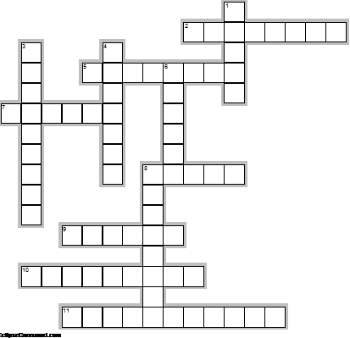
Enjoy this crossword:
Across
2. buying clothes
5. tent accomodation
7. accomodation for young people
8. Hotel next to a motorway
9. collection of art manufacts
10. bedroom, kitchen and services
11. visit important places in a city
Down
1. building with many rentable rooms
3. walk leisurely
4. collection of paintings
6. small apartment with a single kitchen
8. outstanding building or statue

Slide 6
Task Model
Let’s plan what to do on our next school trip.
My suggestion is to go to Cardiff.
Have a look at this inspirational video and at my presentation
https://animoto.com/play/m57NZYYLgpMAdQdANvDZEA
Notes:
Include a short presentation about a city of your choice, to be used by students as a model for their task.

Slide 7
While watching the video you should note down:
What can you see in the first picture? What does it represent?
What places are shown in the second picture?
What can you do there?
Where can you sleep in Cardiff?
What Welsh food can you taste in Cardiff?

Slide 8

CARDIFF
Notes:
These four slides represent the task model, they can be changed according to the teacher’s needs.

Slide 9

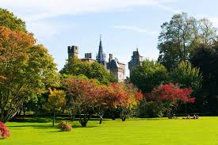
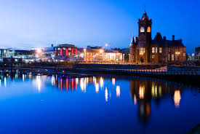
What to do in cardiff
A traditional pub
Bute Park
Cardiff Bay by night

Slide 10
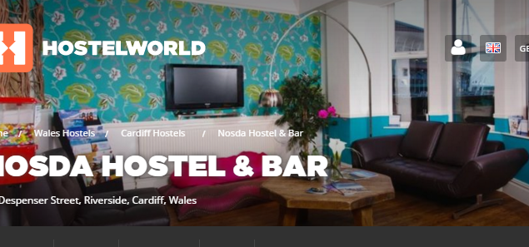

ACCOMMODATION
You
You can either stay in a big hotel or in a youth hostel

Slide 11
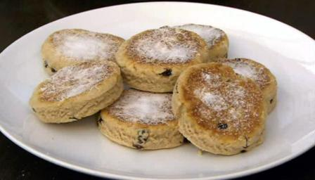
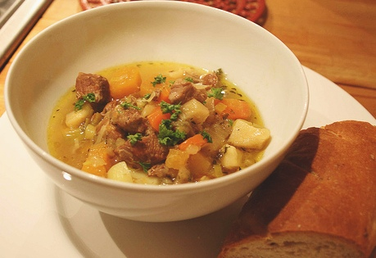
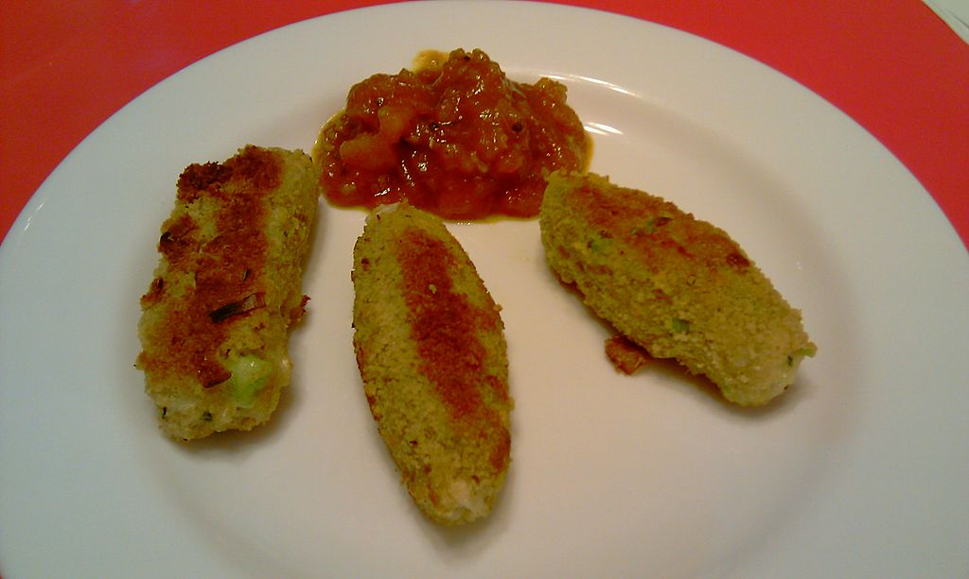
Some food you shouldn't miss out
Cawl , Welsh soup
Welsh cakes
Glamorgan sausages
Notes:
Cawl: Welsh soup; Welsh cakes with raisins; Glamorgan: Welsh sausages

Slide 12
Your task:
Choose a city in Britain and prepare a short Power Point presentation…
and…
convince the class that your suggestion is…
the BEST!!
but…
you have a time limit of 5 minutes!!
Good luck!

Slide 13

Some examples…
Belfast
Liverpool
Manchester
Bath
Cambridge
Swansea
Oxford
Canterbury
Glasgow

Slide 14
Internet resources
www.visitbritain.com here you can have useful information about places to visit
www.tripadvisor.com here you can find any info to plan your visit, form hotels to nice restaurants, from museums to
www.animoto.com a useful tool to make short videos

Slide 15
Useful language
Activities:
go sightseeing/visit museums/stroll in the parks/go shopping/buy souvenirs/taste local food/ go to the beach
Accommodation:
hotel/ motel/hostel/apartments/bed and breakfast/studios/campsite
half board/full board/all inclusive
Food:
sweets, cakes, soup, meat, fish, cheese, potatoes, vegetables, appetizers, main course,

Slide 16
Adjectives:
Which ones would you use for descriptions?
fantastic, awesome, great, terrific
well-known, world famous
worth visiting/trying/doing/seeing
tasty, delicious, tempting
thrilling, daring,
romantic, modern, ancient, futuristic
confortable, cozy, affordable, cheap

Slide 17
Scaffolding language
My presentation will be about…
I’d like to go there because….
There are many…. in…..
I would suggest… because
I recommend… because
As a class we could go there because…
….. is better/more exciting/nearer than ….
considering ….. I think ….. Is great, because…

Slide 18
Useful tips:
Prepare notes about what to say for each slide
Rehearse your presentation aloud, sticking to the time limit
Speak clearly and loudly
Address your audience, not your teacher
Try to be convincing!

Slide 19
Assessment criteria:
Adherence to the topic
Clarity of expression
Timing, interaction with the audience
Choice of appropriate vocabulary
Correct use of elicited structures
Interesting content
Effective use of ICT

